Slide 1
RNAseq Update for HTT Splicing Enhancers
Cross-Cells/Cross-Experiments Off-Target Assessment
HTT SM Splice Modulator Full Team Meeting
Zhen, Dann, Catherine, Joon, Magnus, Jessica
Nov 21, 2022

Slide 2
Main Goals of the Current RNAseq
Discover the compounds have fewer off-targets and but strong on-target effects
Determine the common targets among the SM splicing enhancers
Explore potential novel splicing targets
Confirm the system difference between the different cell-systems (iPSC and NGN2)
Seek the best procedure for cross-experiments/cross-cell-systems comparison
Make robust and cost-efficient experimental design, QC etc.
Sep 26, 2022
Zhen, Dann, Catherine, Joon, Magnus, Jessica

Slide 3
RNA-seq Study #1
Goal: Transcriptome-wide RNA-seq of Benchmark/competitor HTT splice modulators and current BIIB lead compounds in neurons and proliferating cell type for off-target profiling.
Compound | CRL HTRF IC50 (nM) | Internal HTRF IC50 (nM) | Internal iPSC qPCR IC50 (nM) | Internal NGN2 qPCR IC50 (nM) | ~3x IC50 Dose (nM) | Actual X-fold IC50 (iPSC) | Actual X-fold IC50 (NGN2) | ~10x IC50 Dose (nM) | Actual X-fold IC50 (iPSC) | Actual X-fold IC50 (NGN2) | Notes
BIO-1755497 | 121 | 4 | 10.75 | 3.023 | 12 | 1.12 | 3.97 | 40 | 3.72 | 13.23 | Branaplam
BIO-2006152 | 87 | 15 | 14.14 | 7.6185 | 45 | 3.18 | 5.91 | 150 | 10.61 | 19.69 | PTC-518 guess
BIO-2059811 | 87 | Expected <100nM | 101.5 | 65.19 | 261 | 2.57 | 4.00 | 870 | 8.57 | 13.35 | PTC different core
BIO-2135644 | 100 | Expected <100nM | 81.68 | 68.31 | 300 | 3.67 | 4.39 | 1000 | 12.24 | 14.64 | PTC different core
BIO-2136770 | 100 | Expected <100nM | 41 | 24.59 | 300 | 7.32 | 12.20 | 1000 | 24.39 | 40.67 | Close PTC518 analog
BIO-1949634 | 1500 | 6200 | 357.55 | 289 | 3000 | 8.39 | 10.38 | 10000 | 27.97 | 34.60 | Risdiplam
BIO-2060573 | 5780 | 670 | 298.2 | 271.5 | 3000 | 10.06 | 11.05 | 10000 | 33.53 | 36.83 | Internal lead/different core
BIO-2070692 | 560 | 50 | 140.4 | 104.4 | 1680 | 11.97 | 16.09 | 5600 | 39.89 | 53.64 | Remix example
BIO-2060884 | 370 | 240 | 113.8 | 105.9 | 3700 | 32.51 | 34.94 | 10000 | 87.87 | 94.43 | Internal lead
DMSO | - | - | - | - | - | - |  | -
 |  |  | Determined after RNAseq study |  |  | Determined after RNAseq study |  |  | Determined after RNAseq study
*Dosed correctly and used as reference across RNAseq studies
7189L WT Cell lines:
iPSCs (100K)
NGN2 (DIV14, 200K)
Treatment:
24hr
Replicates:
3 biological
Total Samples:
114 (9 cpds + DMSO)

Slide 4
RNA-seq Study #2
Goal: Transcriptome-wide RNA-seq of potent BIIB lead compounds in neurons and proliferating cell type for off-target profiling in comparison to PTC518 and other competitor compounds.
Compound | Internal HTRF IC50 (nM) | Internal iPSC qPCR IC50 (nM) | Internal NGN2 qPCR IC50 (nM) | ~3x IC50 (iPSC) | ~10x IC50 (iPSC) | ~3x IC50 (NGN2) | ~10x IC50 (NGN2) | Notes
BIO-2006152 | 15.0 | 14.14 | 7.62 | 42 | 141 | 23 | 76 | REFERENCE, ~PTC-518
BIO-2175420 | 11.5 | 14.50 | 5.28 | 43 | 145 | 16 | 53 | great KPuu imidazopyridine
BIO-2139701 | 38.3 | 19.95 | 5.60 | 60 | 199 | 17 | 56 | imidazopyridine other RHS
BIO-2176866 | 91.7 | 70.41 | 8.83 | 211 | 704 | 26 | 88 | benzimidazole
BIO-2184088 | 21.0 | 26.18 | 11.16 | 79 | 262 | 33 | 112 | sulfur
BIO-2184090 | 65.0 | 49.36 | 30.86 | 148 | 494 | 93 | 309 | sulfur other RHS
BIO-2174714 | 191.0 | 113.90 | 52.60 | 342 | 1139 | 158 | 526 | indazole
BIO-2186960 | 32.9 | 16.77 | 10.18 | 50 | 168 | 31 | 102 | triazole 1
BIO-2186527 | 36.4 | 32.36 | 19.24 | 97 | 324 | 58 | 192 | triazole 2
BIO-2174748 | 74.5 | 37.62 | 22.08 | 113 | 376 | 66 | 221 | oxazole
BIO-2184741 | 56.0 | 147.60 | 96.21 | 443 | 1476 | 289 | 962 | BENCHMARK, Remix cpd
DMSO | - | - | - | - | - | - | -
7189L WT Cell lines:
iPSCs (100K)
NGN2 (DIV14, 200K)
Treatment:
24hr
Replicates:
4 biological
Total Samples:
192 (11 cpds + DMSO)

Slide 5
Structures of Some SM Splicing Enhancers

Slide 6
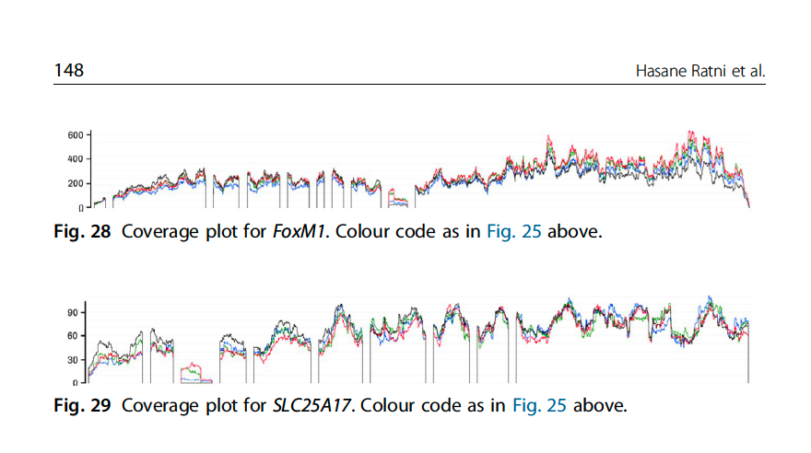
On-Targets and Off-Targets sequences
 | Doner Splice Site Consensus
 | AG|GTRAG
Gene Names | Risdiplam Consensus Binding sequence
HTT | AGA|GTTAG
APLP2 | GA|GTAAG
FOXM1-inside | GA|GTAAG
FOXM1-border | CA|GTAAG
SLC25A17-inside | GA|GTAAG
SLC25A17-border | AG|GTTAA
ref:
Ratni Roche review, Progress Medicinal Chem V58, 2019
Anuradha Bhattacharyya et. Al. Nature Comm. 2021

Slide 7
Sample similarity from Gene Expression (1st exp)
PCA in 2D for iPSC
PCA in 2D for NGN2

Slide 8
Sample similarity from Gene Expression (2nd exp raw)
PCA in 2D for iPSC
PCA in 2D for NGN2

Slide 9
Sample similarity from Gene Expression (2nd exp raw after removal of low-quality samples)
PCA in 2D for iPSC
PCA in 2D for NGN2

Slide 10
Sample similarity from Gene Expression (2nd exp raw after removal of R4)
PCA in 2D for iPSC
PCA in 2D for NGN2

Slide 11
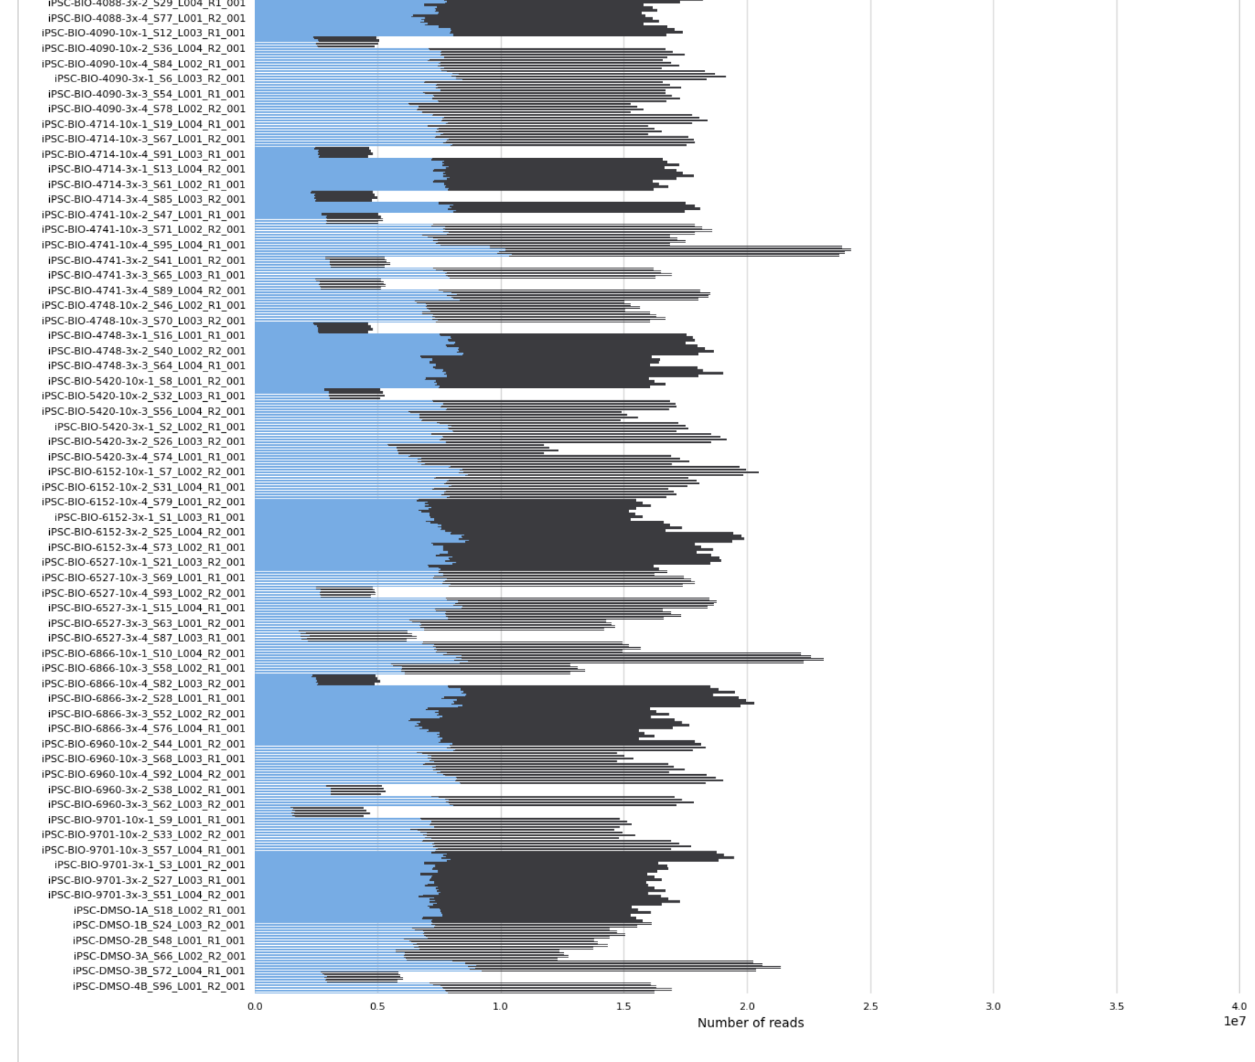
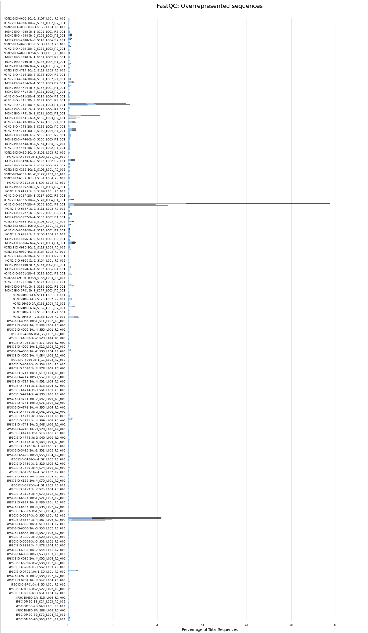
MultiQC
Total Reads
Overrepresented Sequences %
/Users/zgao1/Documents/RNAseq/TST11955_BACK/QC/MultiQC Report_TST11955.html

Slide 12
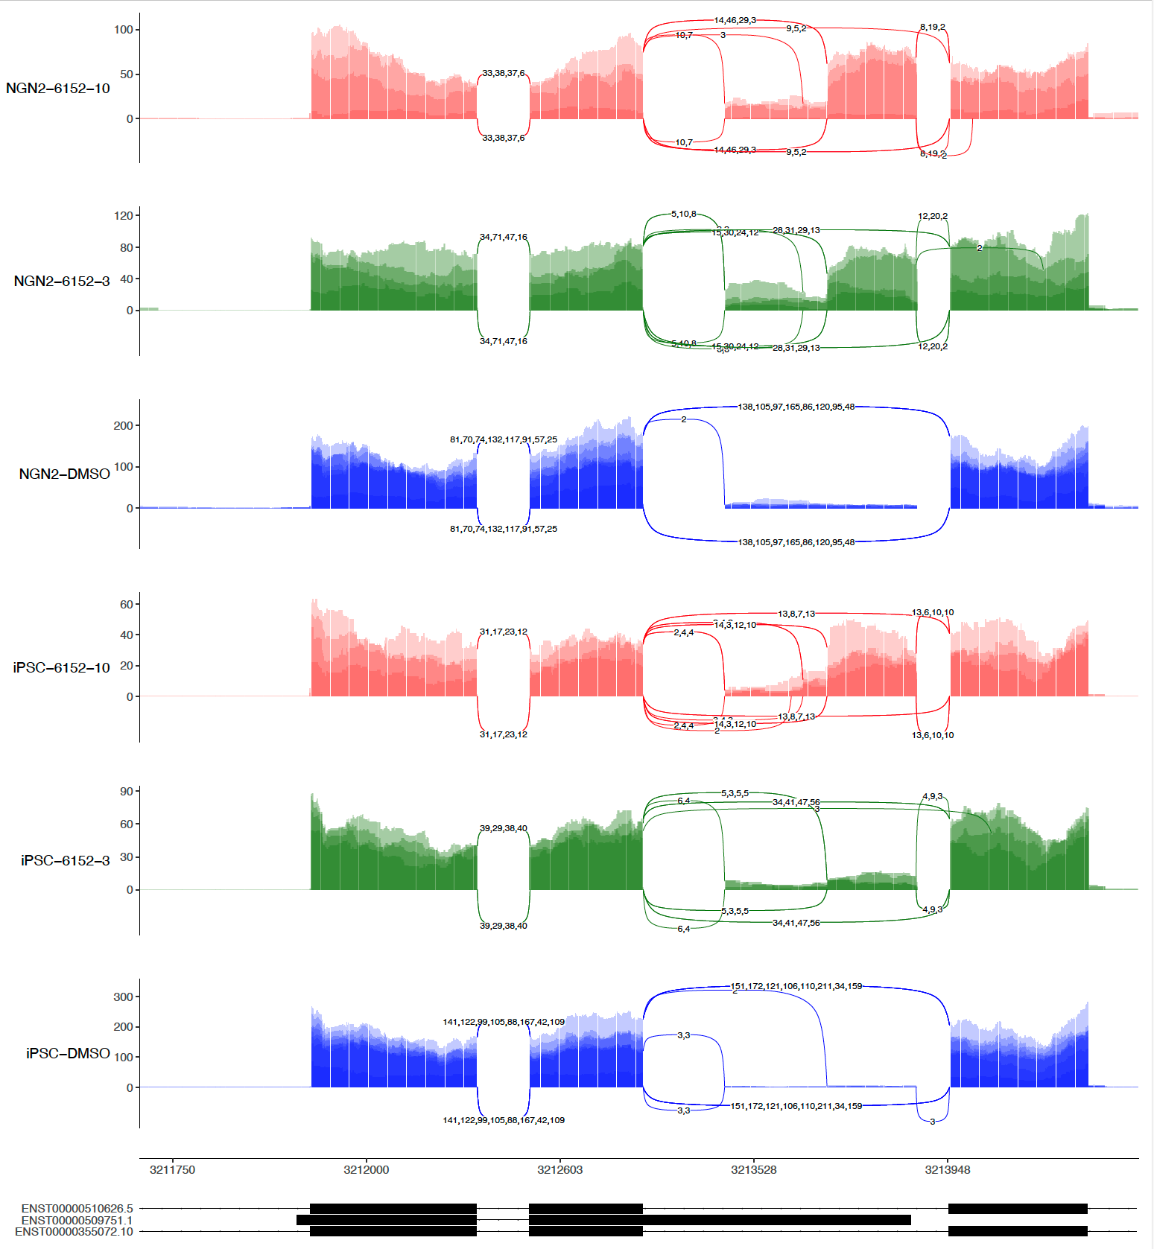
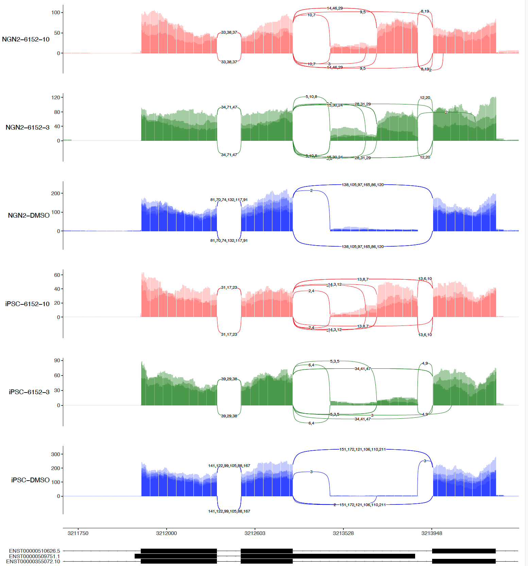
sashimi-plots: HTT gene in 2nd 6152 (4 vs 3 Repeats)
4 repeats
3 repeats (No R4)

Slide 13
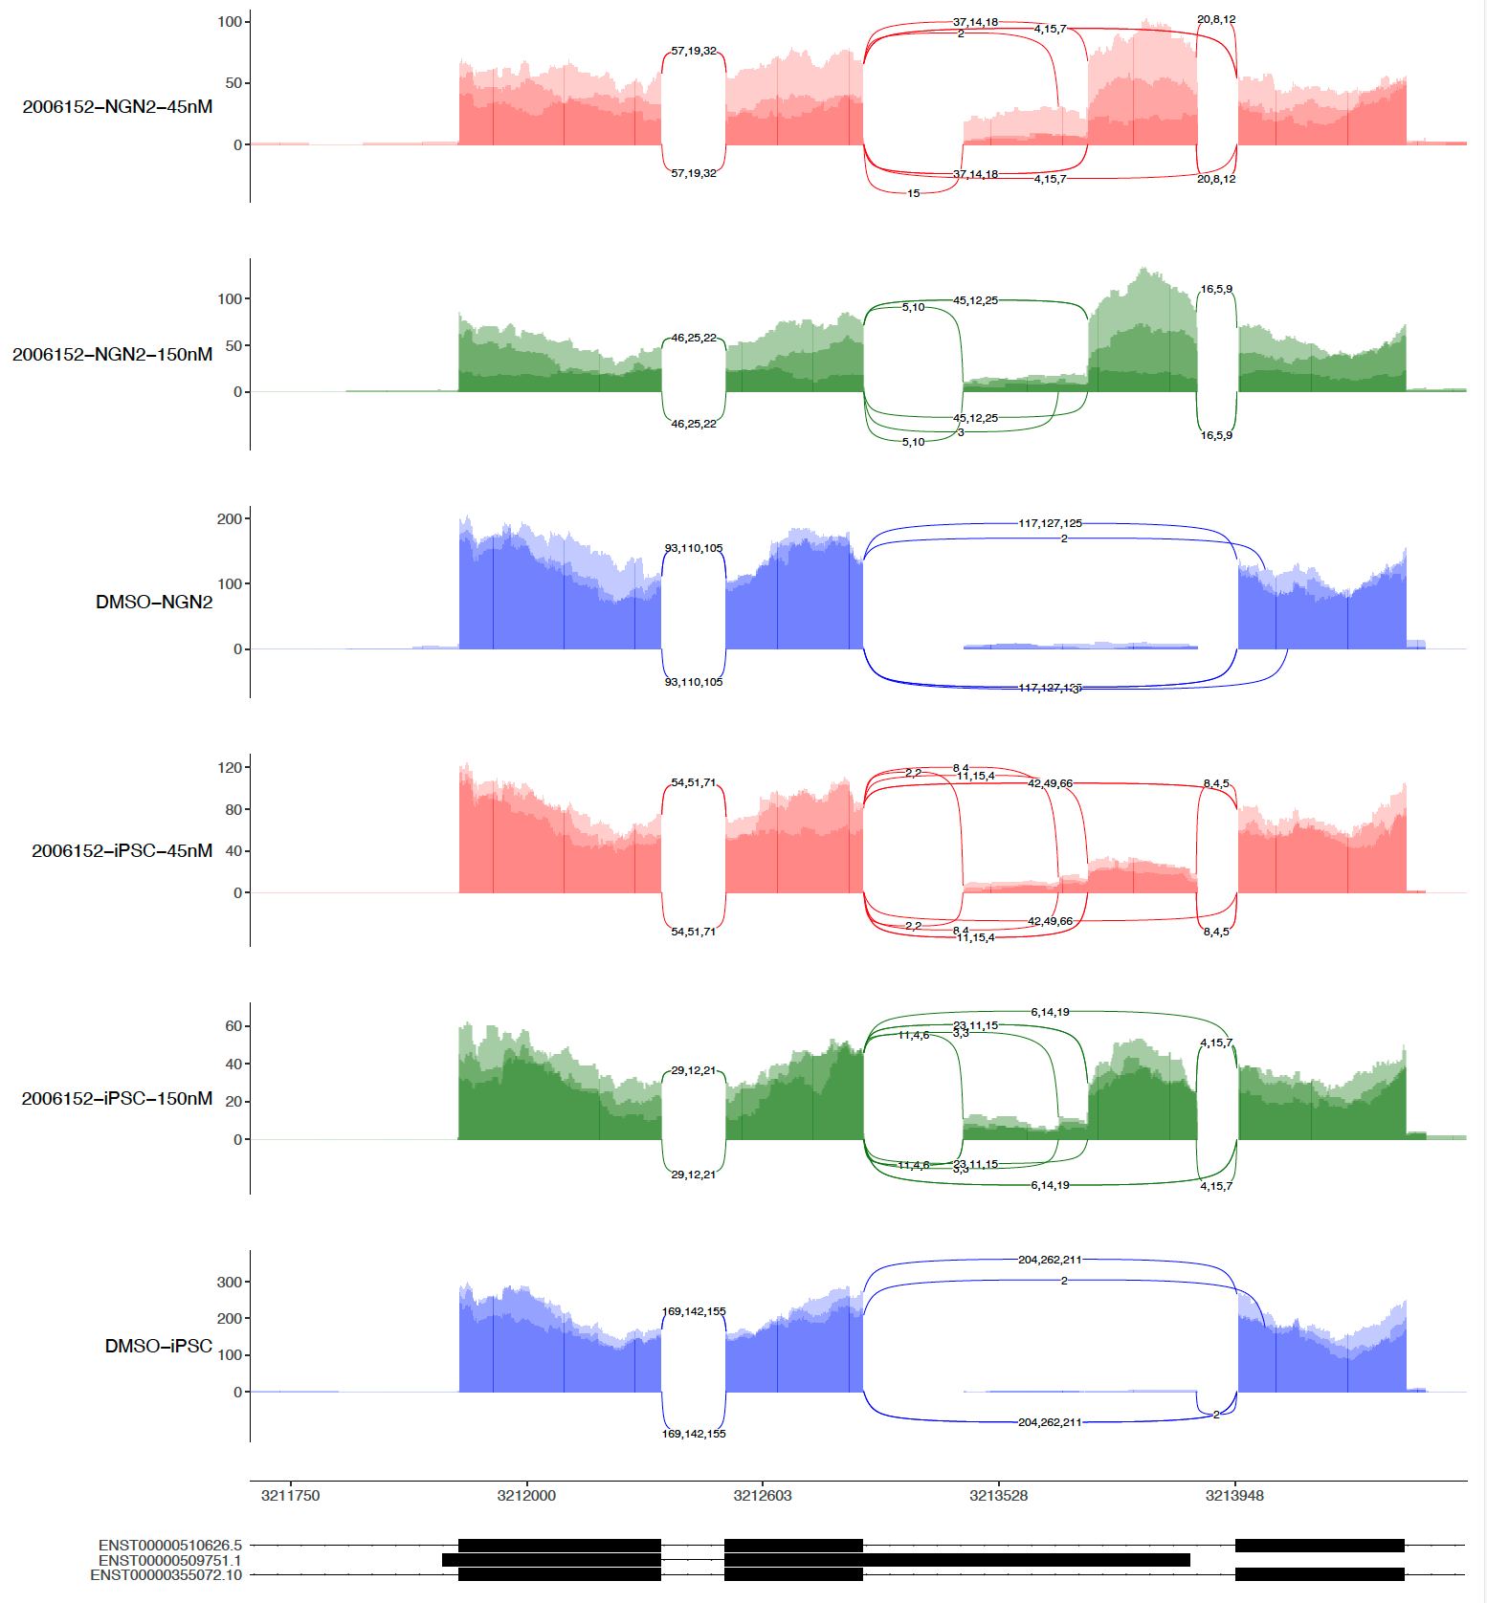
sashimi-plots: HTT gene in 1st and 2nd 6152
1
2
3
4

Slide 14
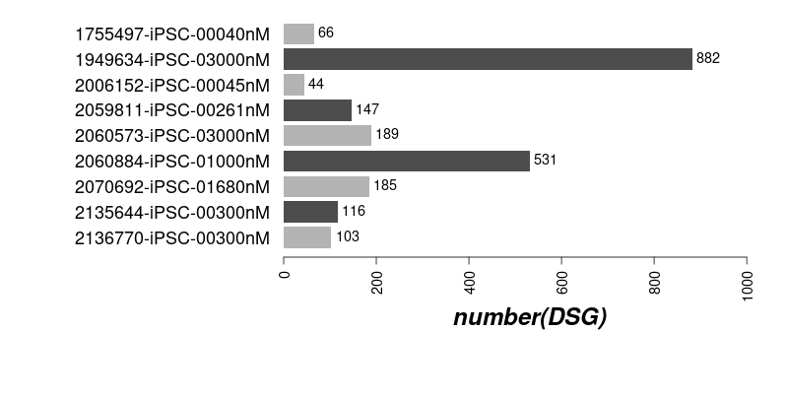
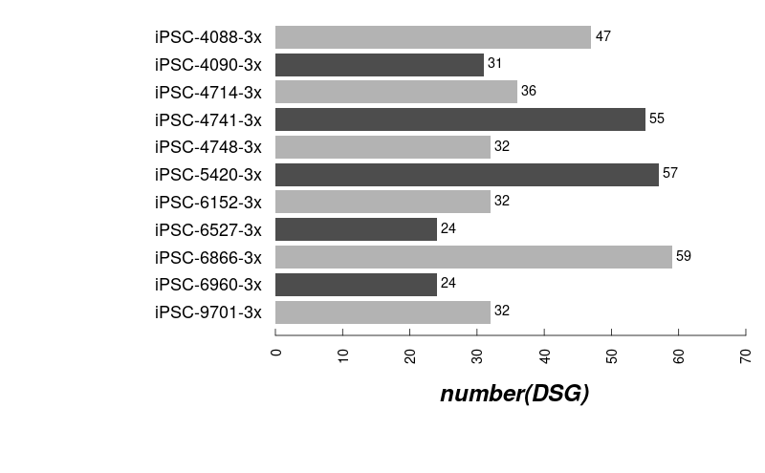
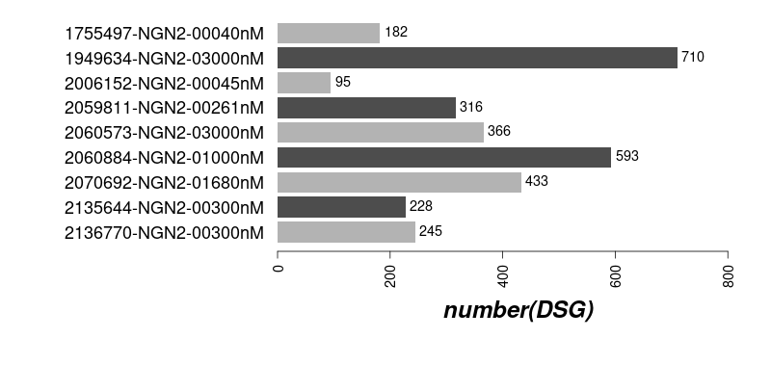
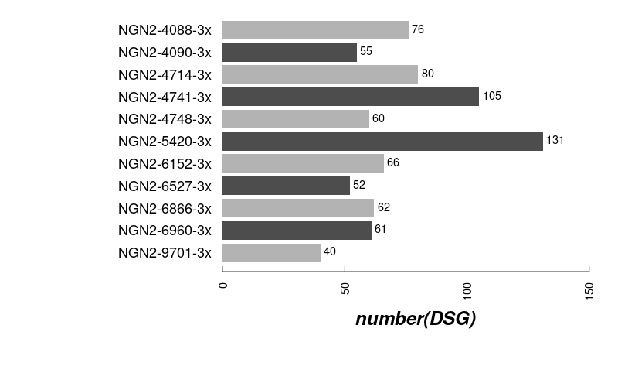
The numbers of DSG induced by compounds (3x)
1st iPSC
2nd iPSC
1st NGN2
2nd NGN2

Slide 15
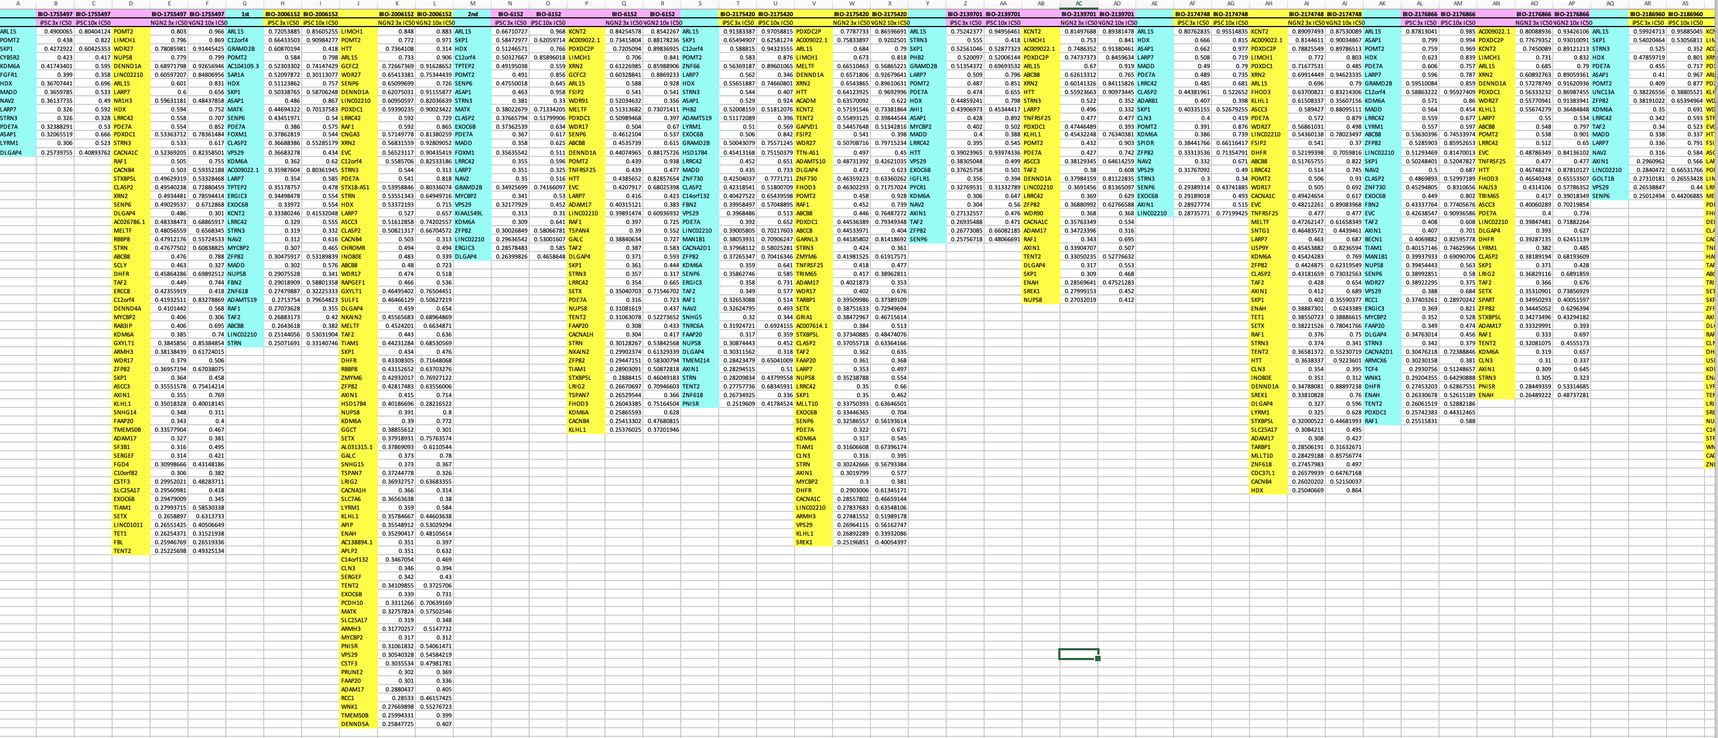
The details DSG induced by compounds (3x & 10x)
6152 1st iPSC & NGN2 and 2nd iPSC & NGN2

Slide 16

The DSG Induced by Compounds in the 2 cell systems

Slide 17
The Clustering of Compounds in the 2 cell systems

Slide 18
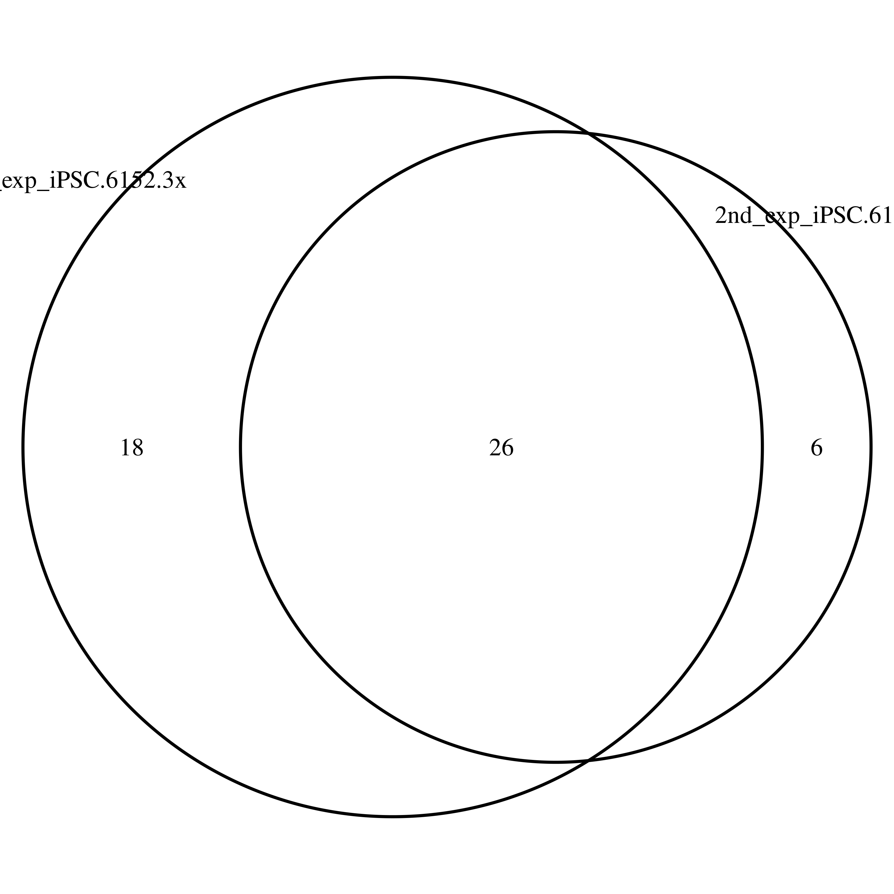
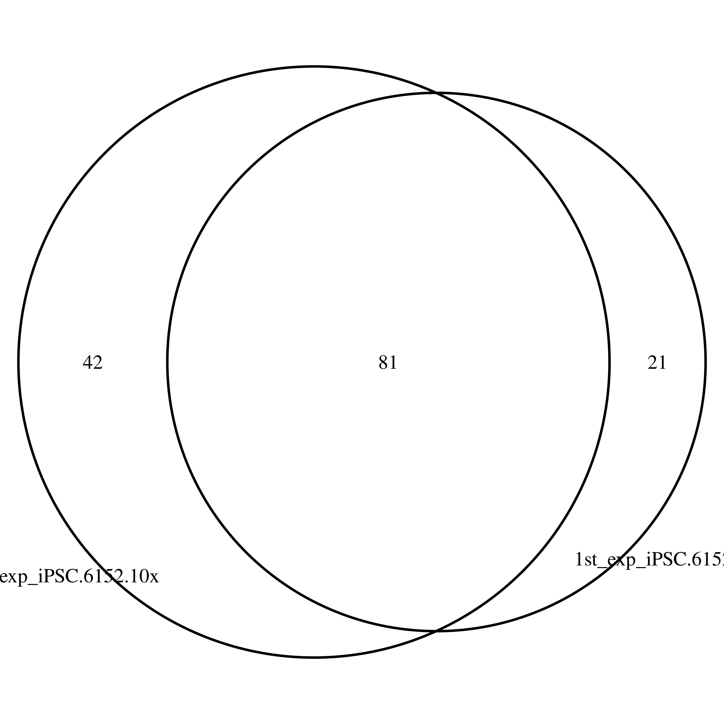
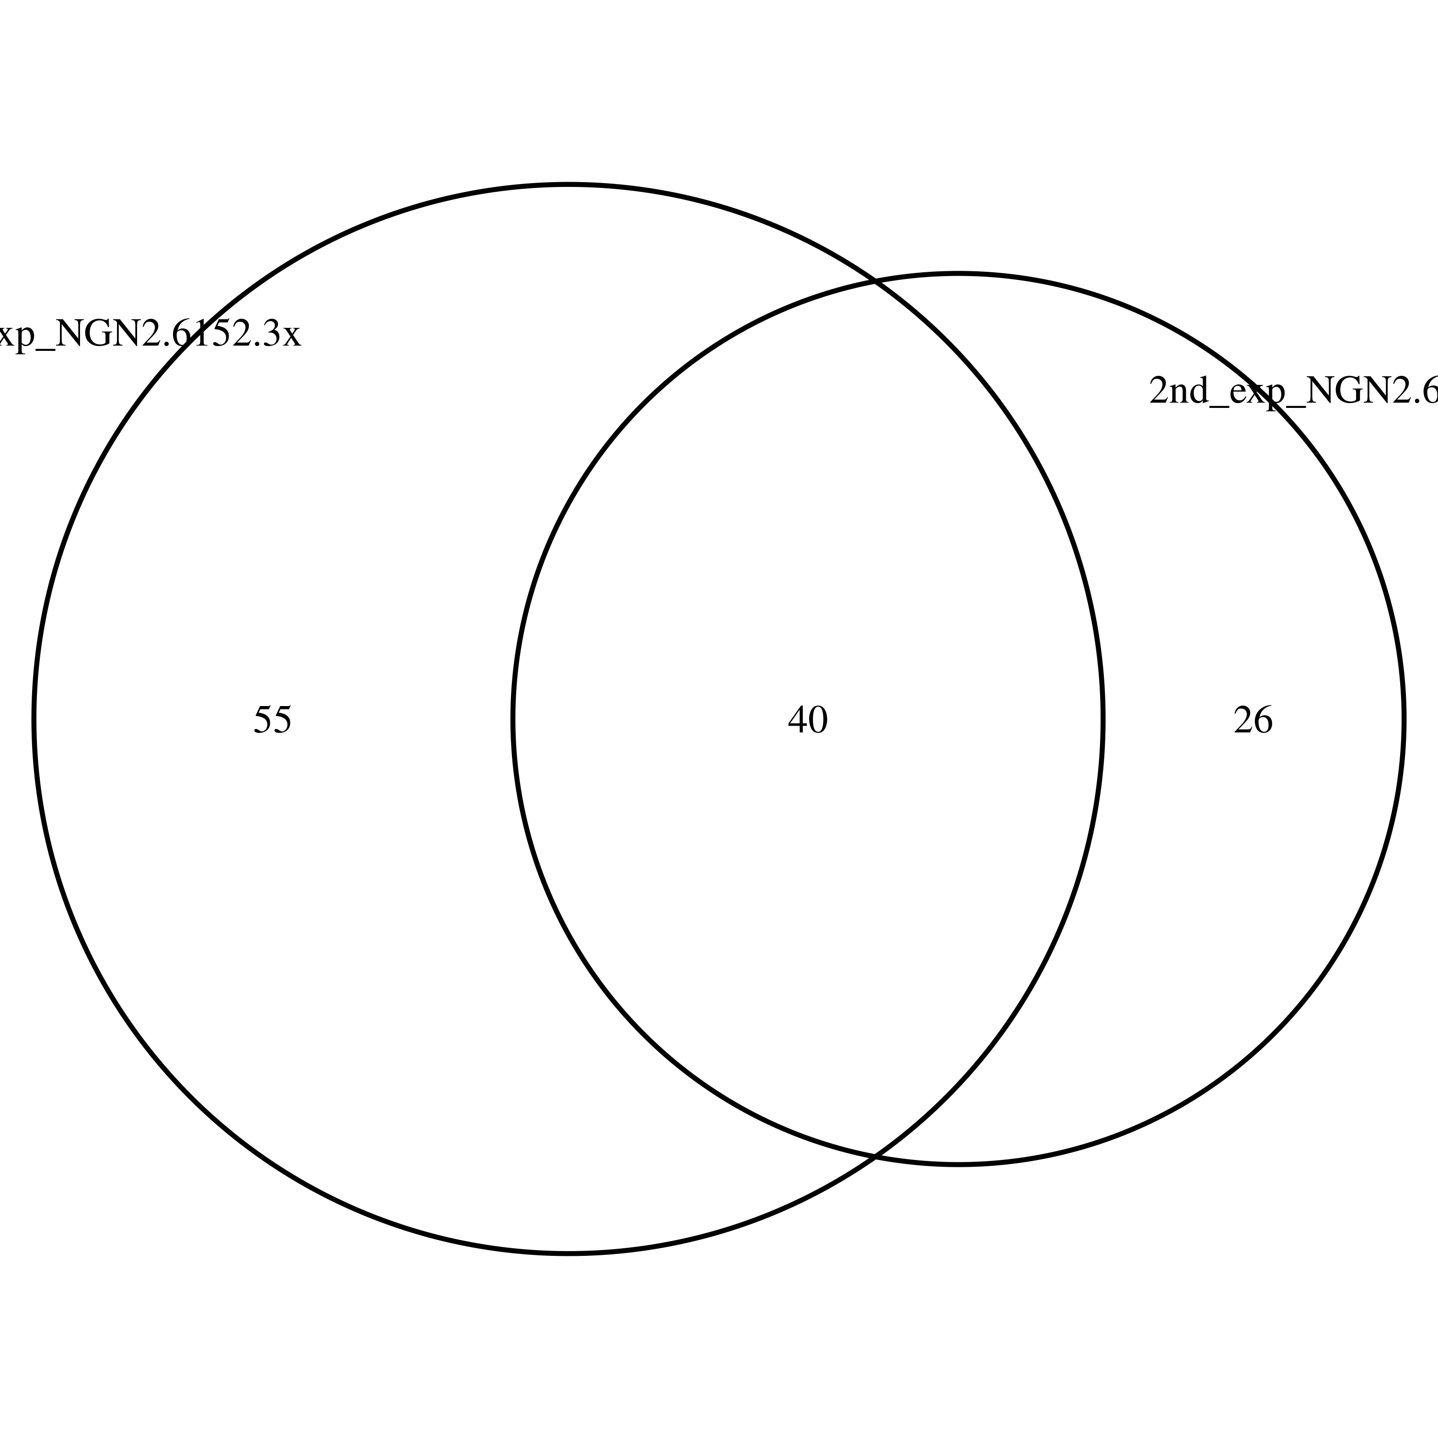
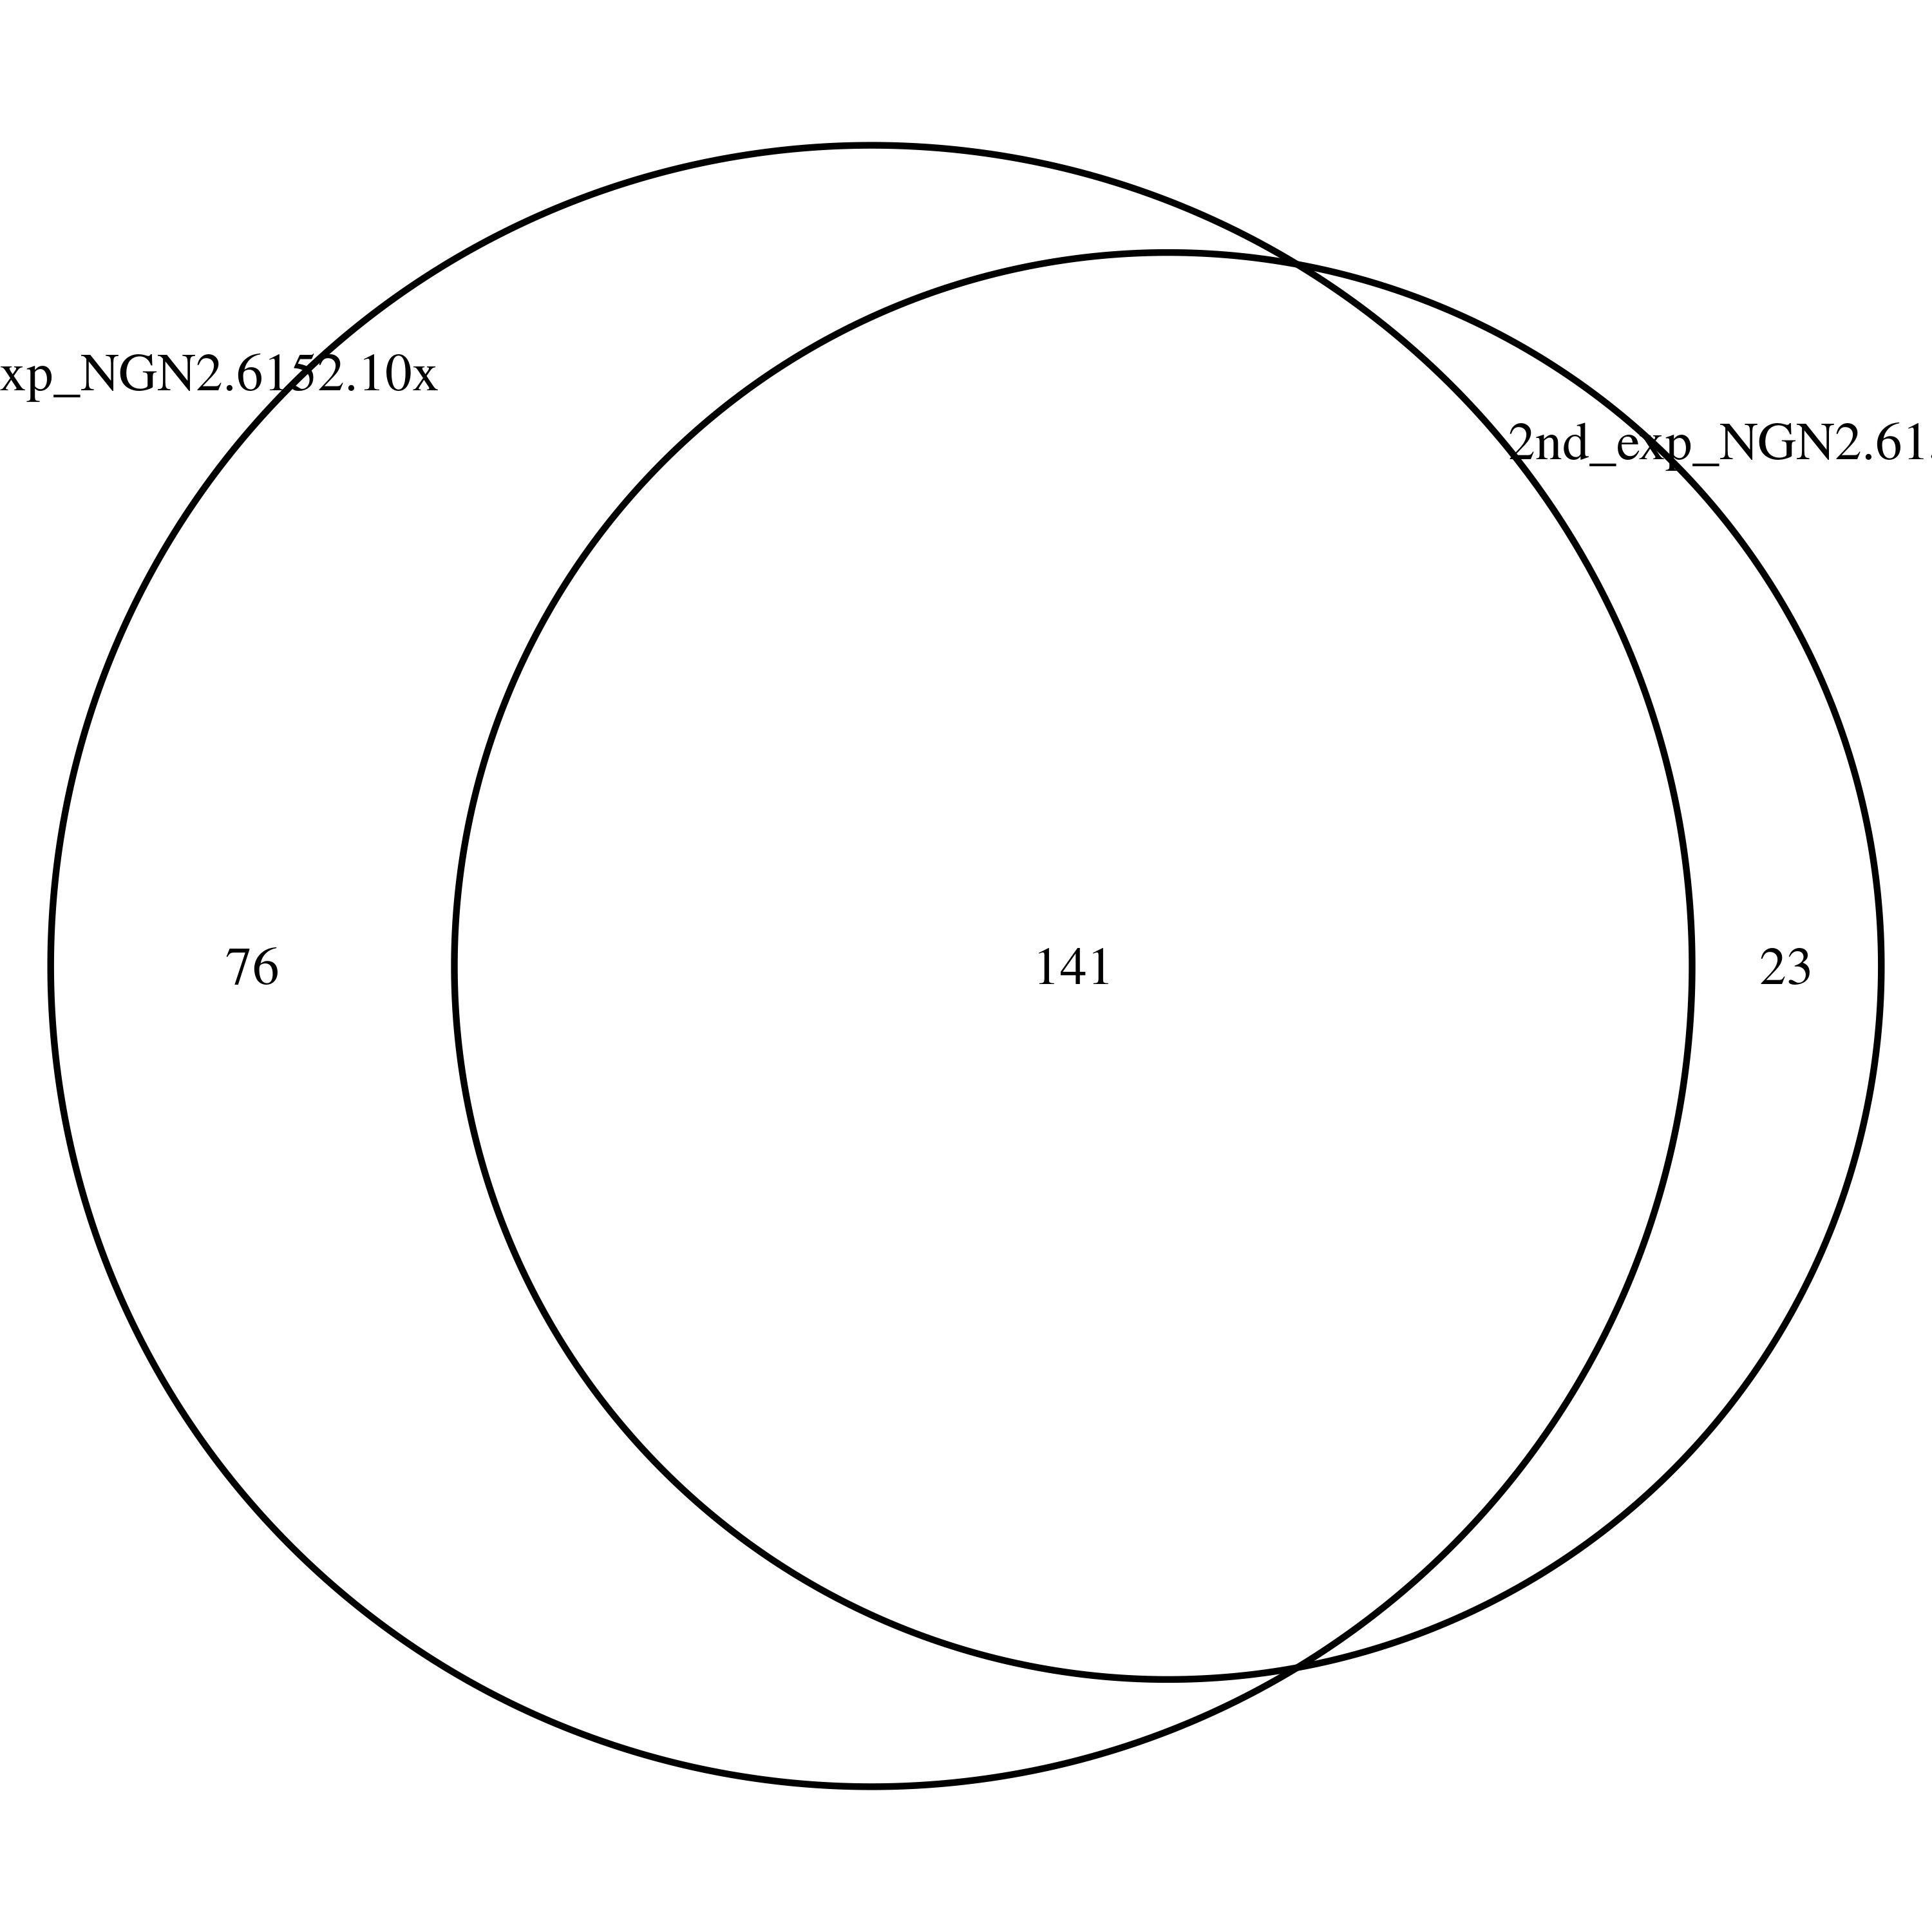
Overlapped DSG (1st and 2nd Exp.)
1st and 2nd exp. of 6152-3x in iPSC
1st and 2nd exp. of 6152-10x in iPSC
1st and 2nd exp. of 6152-3x in NGN2
1st and 2nd exp. of 6152-10x in NGN2

Slide 19
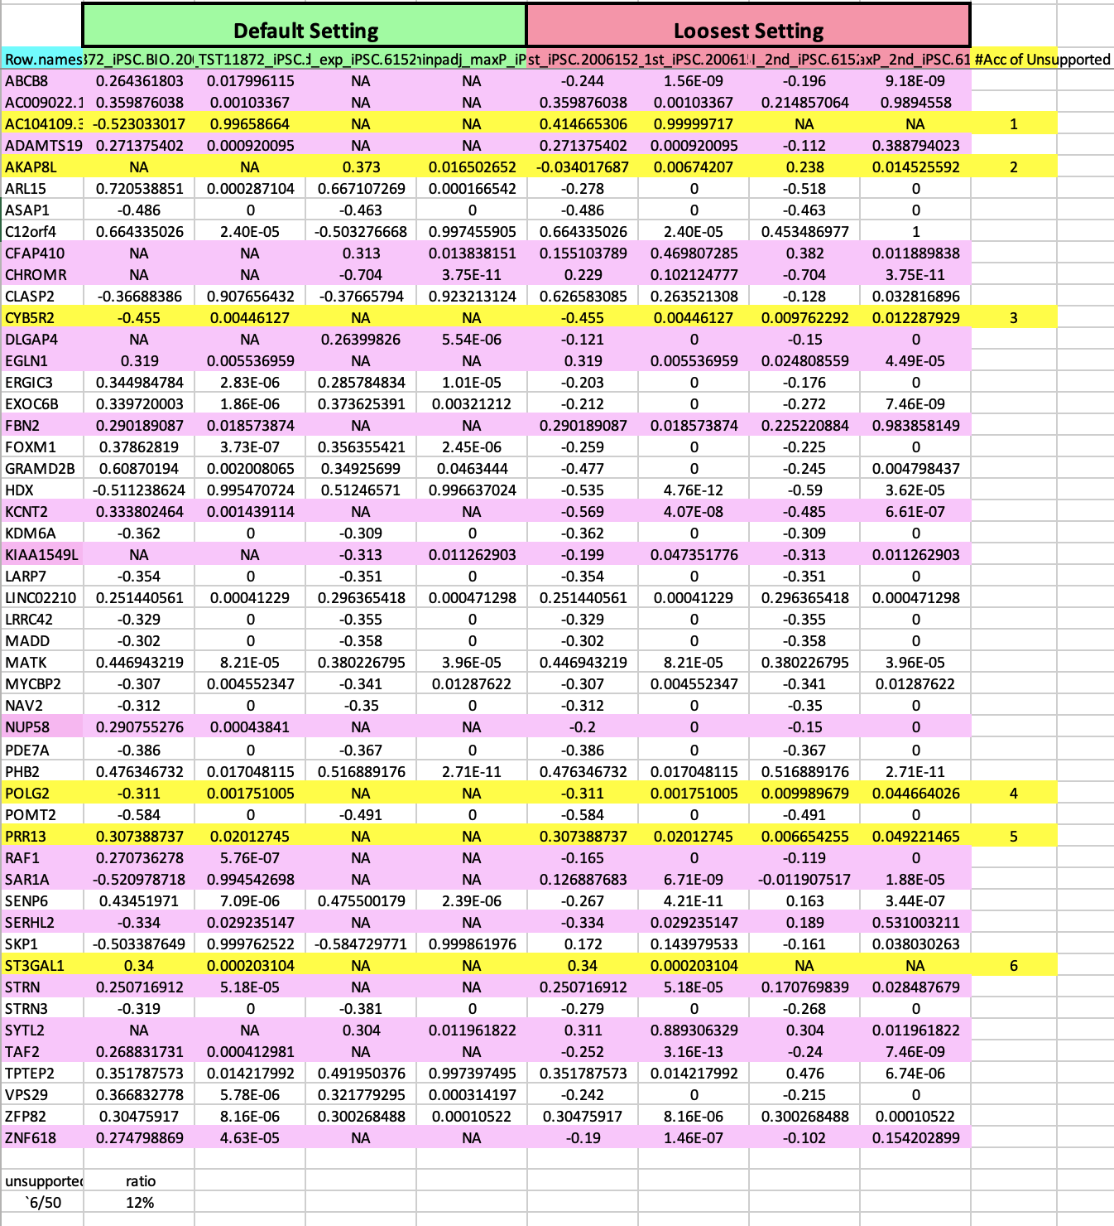
Overlapped DSG (1st and 2nd batch mutual support)
1st and 2nd batch of 6152-3x in iPSC

Slide 20
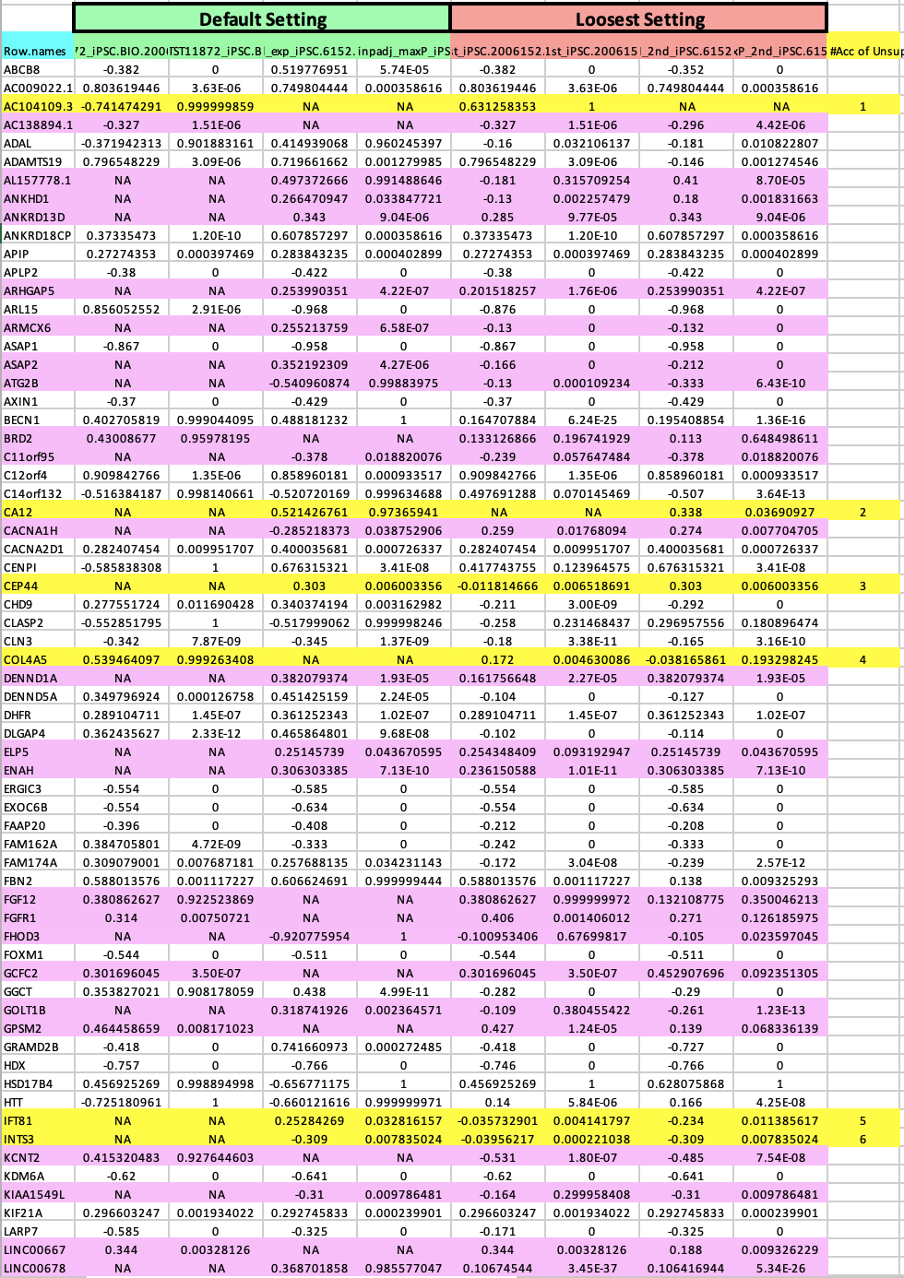
Overlapped DSG (1st and 2nd batch mutual support)
1st and 2nd batch of 6152-10x in iPSC

Slide 21
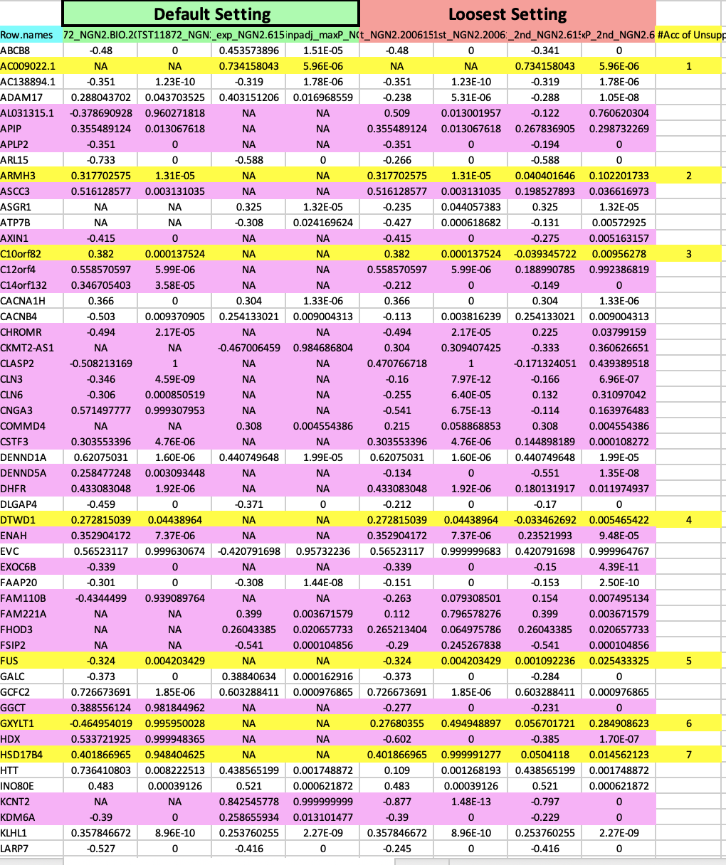
Overlapped DSG (1st and 2nd batch mutual support)
1st and 2nd batch of 6152-3x in NGN2

Slide 22
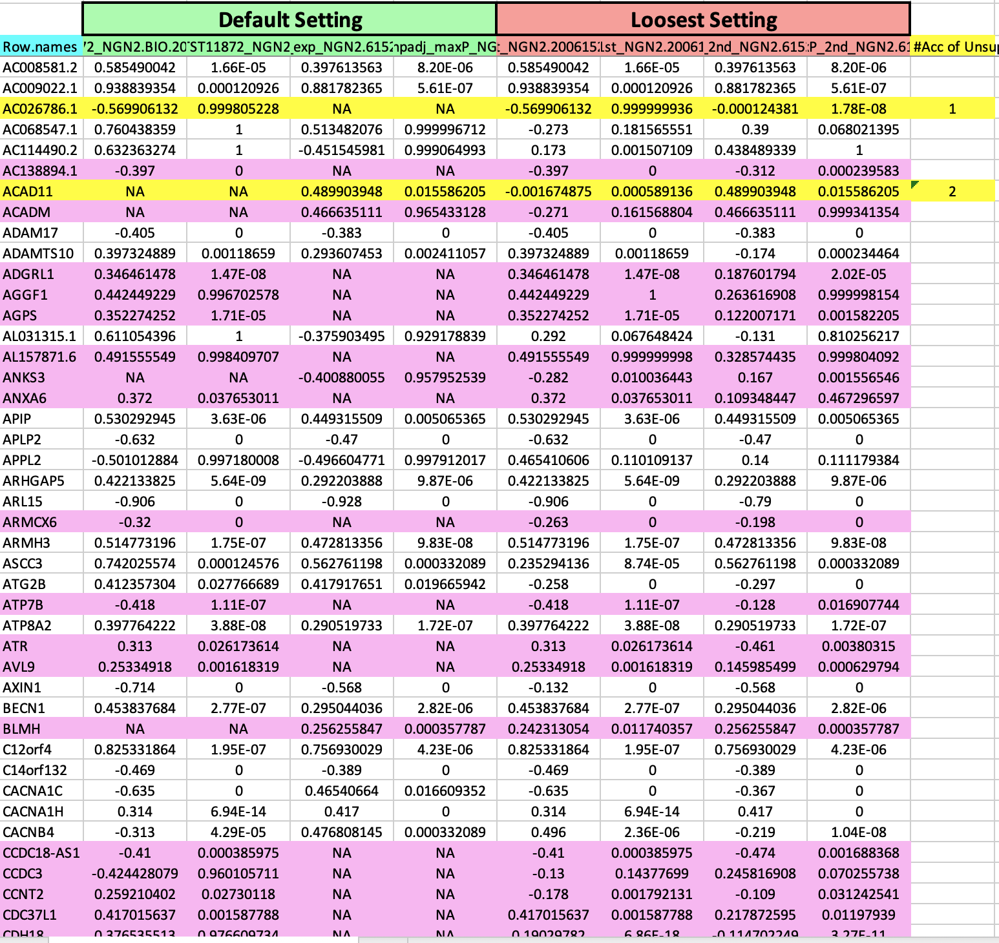
Overlapped DSG (1st and 2nd batch mutual support)
1st and 2nd batch of 6152-10x in NGN2

Slide 23
Conclusion and Next Steps
Ranked the compounds have fewer off-targets
Showed the common targets among the SM splicing enhancers
Explore potential novel splicing targets
Confirm the system difference between the different cell-systems (iPSC and NGN2)
Next steps
Preclinical Safety Assessment
RASLseq primer design for cost-efficient screen

Slide 24

Thank you everyone!

Slide 29
Overlapped DSG
iPSC vs NGN2 cells
1st batch vs 2nd batch
DSG consistency
Across compounds comparison

Slide 30
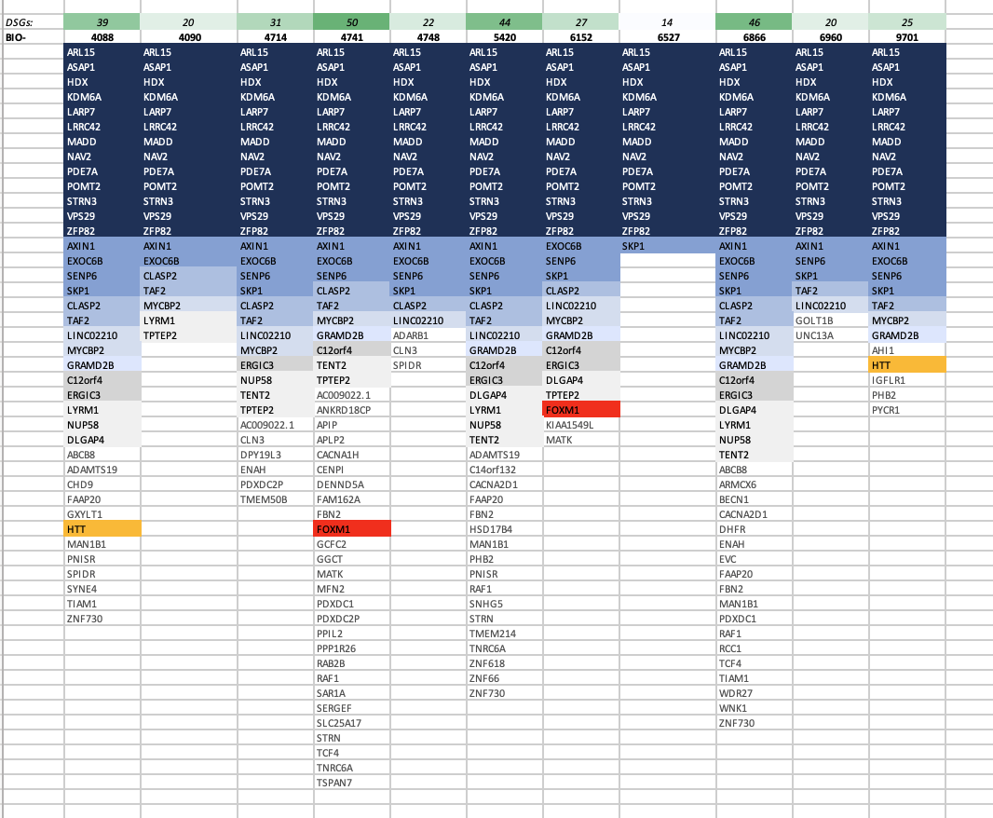
Compounds consistency
DSG across multiple compounds in iPSC cells

Slide 31
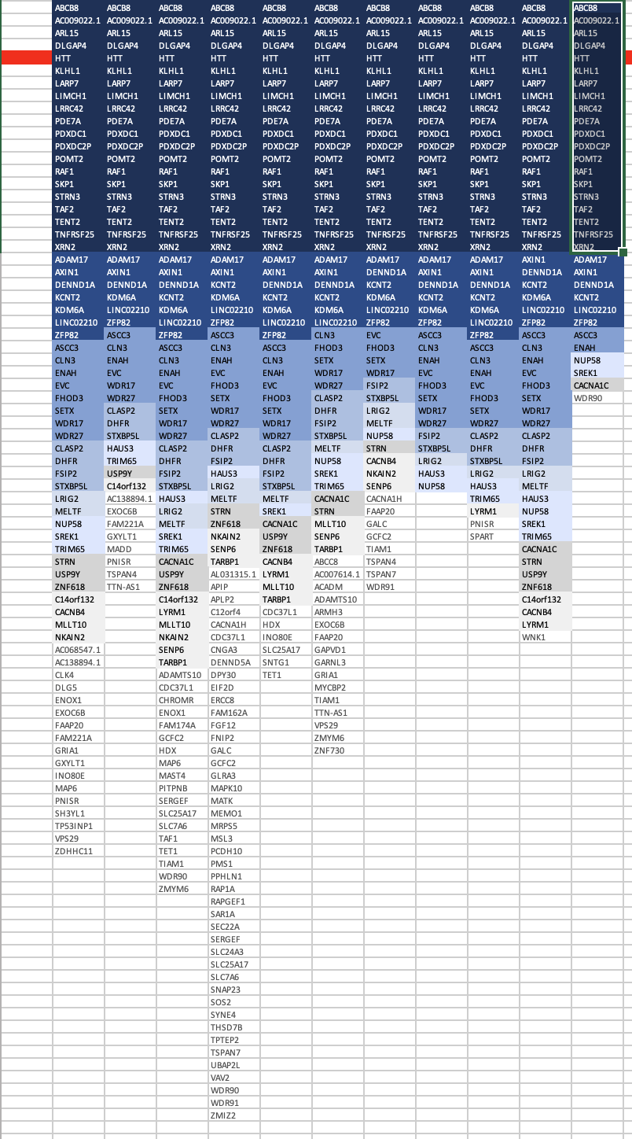
Compounds consistency
DSG across multiple compounds in NGN2 cells

Slide 32
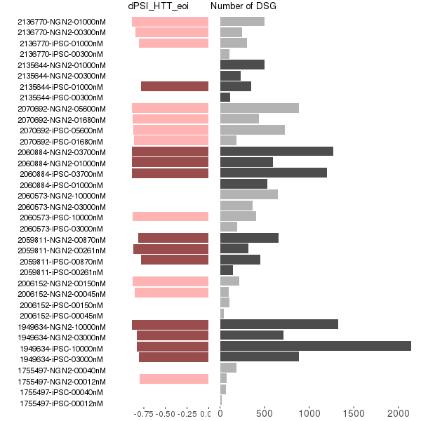
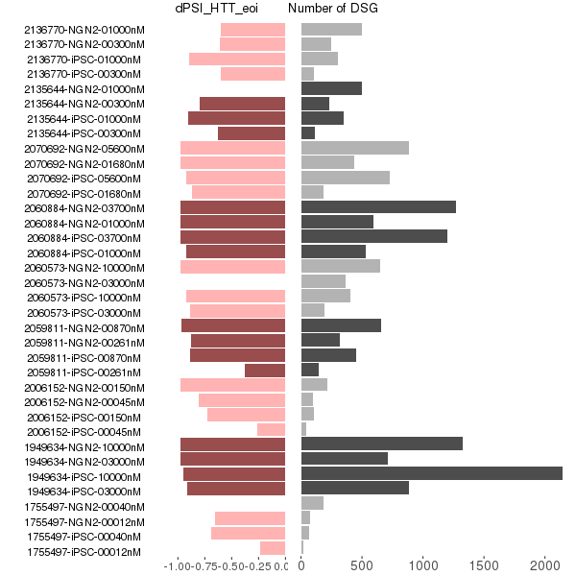
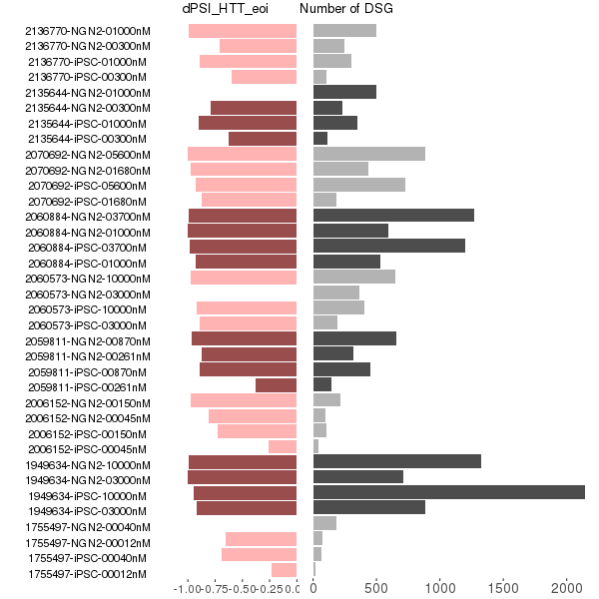
DSG and dPSI in eoi (1st batch)
Updated dPSI from leafcutter
dPSI from majiq
leafcutter majiq merged

Slide 33
Overlapped DSG (1st and 2nd batch)
1st and 2nd batch of 6152-3x in iPSC
1st and 2nd batch of 6152-3x in iPSC
1st and 2nd batch of 6152-3x in NGN2
1st and 2nd batch of 6152-10x in iPSC

Slide 34
Overlapped DSG (1st and 2nd batch mutual support)
1st and 2nd batch of 6152-3x in iPSC

Slide 35
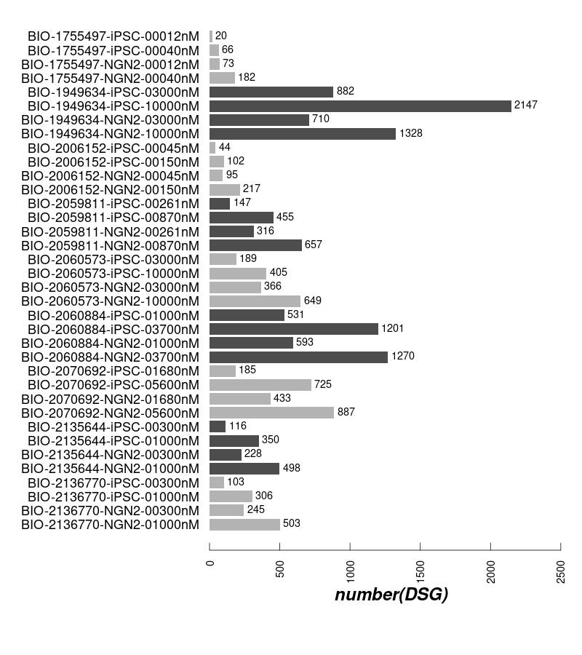
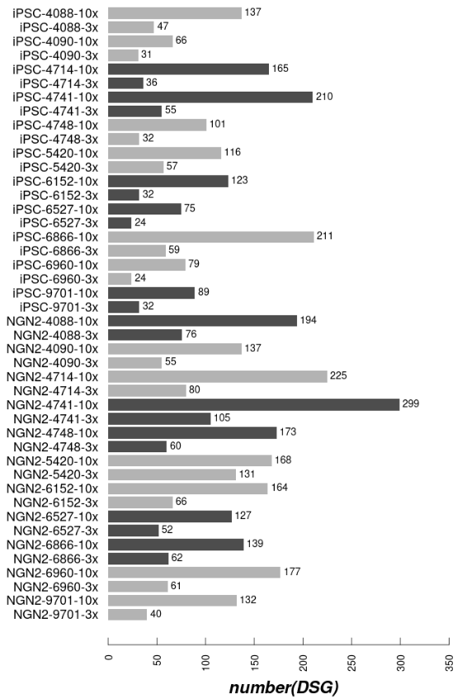
DSG: 1st batch and 2nd batch
1st batch
2nd batch

Slide 36
Design

Slide 37
QC

Slide 38
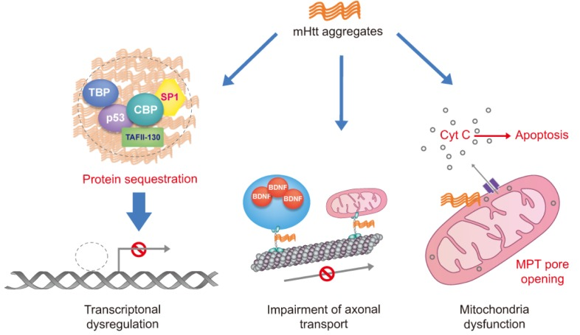
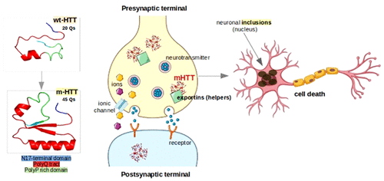
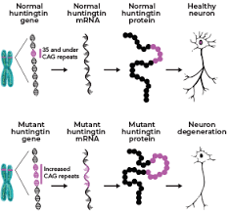
Huntingtin protein (HTT) and Huntington Diseass (HD)
(A)
(B)
(C)
mHTT is believed be responsible for Huntington’s Disease (HD)
wtHTT contains fewer (not more than 35 Qs) polyglutamine residues while mHTT has more than 35 Qs
A general assumption: short polyP domain is that it might act as an antagonist for β-sheet formation and keep HTT soluble
Plots from Sanda Nastasia et al.

Slide 39
Key points:
Goals of study/analysis
Study design
Summary of QC of results
Deep dive into off targets, e.g
Visualizations of OT frequencies, rankings, etc.
Similarities/differences between compound profiles in each cell type
Similarities/differences between cell types

Slide 40
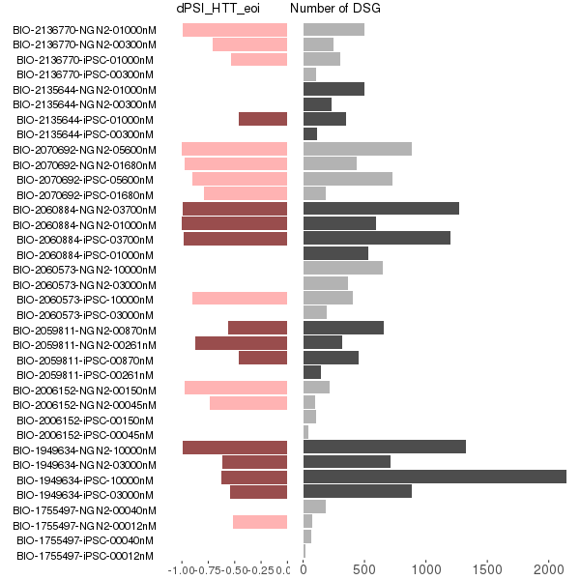
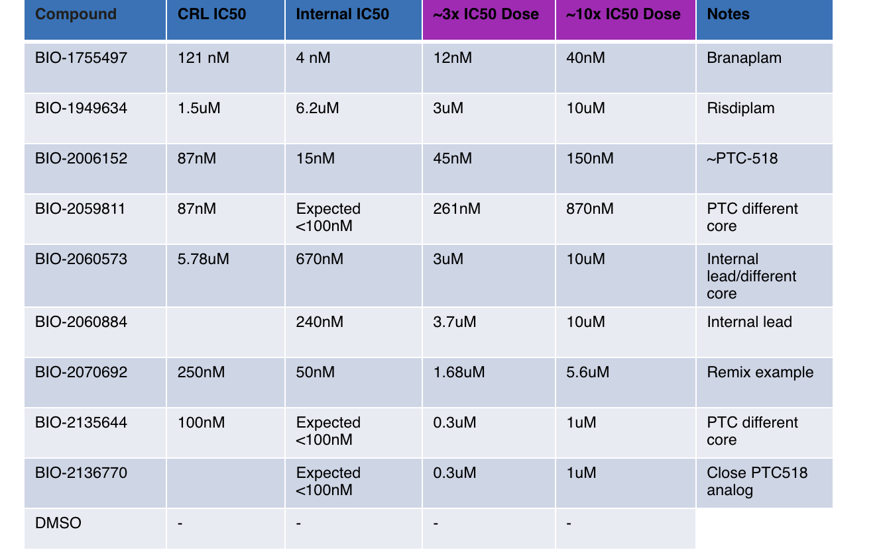
DSG and dPSI in eoi

Slide 41
Sample similarity from Gene Expression
Expression heatmap for iPSC
Expression heatmap for NGN2

Slide 42
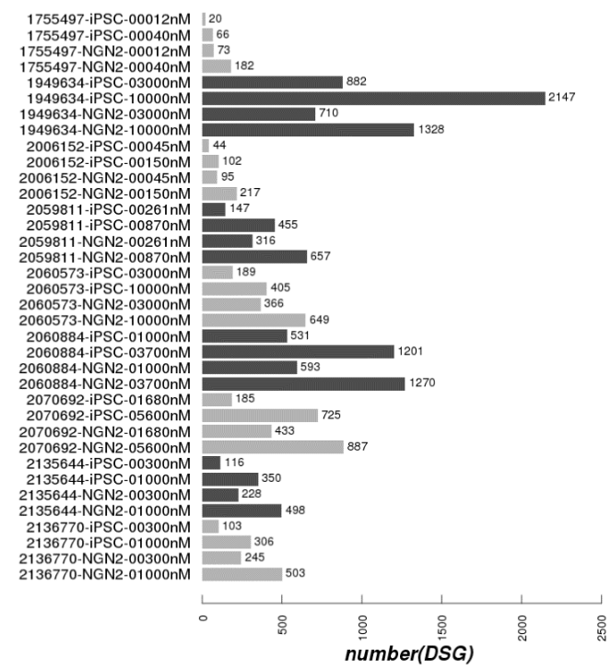
42

Slide 43
On-Targets and Off-Targets sequences
 | Doner Splice Site Consensus
 | AG|GURAGU
Gene Names | Risdiplam Consensus Binding sequence
SMN2 | GA|GTAAGT
APLP2 | GA|GTAAGT
FOXM1-inside | GA|GTAAGT
FOXM1-border | CA|GTAAGT
SLC25A17-inside | GA|GTAAGA
SLC25A17-border | AG|GTTAAA
(ref: Ratni Roche review, Progress Medicinal Chem V58, 2019)

